Slide 1

Week # 10
Operations Research
(Software Engineering)

Slide 2
Modified Distribution method(Modi)
Modi method is the further optimization of the Vogel's approximation

Slide 3
Modi method(u-v method)
TO FROM | Peshawar |  | Sialkot |  | Multan |  | FACTORY CAPACITY/Supply
Karachi | 13 |  | 11 |  | 40 |  | 2
Lahore | 18 |  | 18 |  | 12 |  | 7
Requirement/ Demand | 1 |  | 3 |  | 5

Slide 4
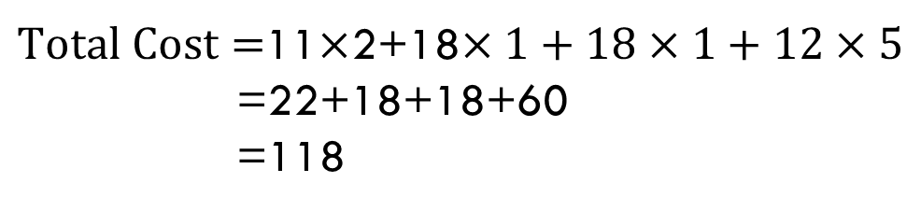
Modi method(u-v method)
TO FROM | Peshawar |  | Sialkot |  | Multan |  | FACTORY CAPACITY/Supply
Karachi | 13 |  | 11 | 2 | 40 |  | 2
Lahore | 18 | 1 | 18 | 1 | 12 | 5 | 7
Requirement/ Demand | 1 |  | 3 |  | 5
$Total Cost=$11$×$2+18$×1+18×1+12×5$
=22+18+18+60
=118

Slide 5
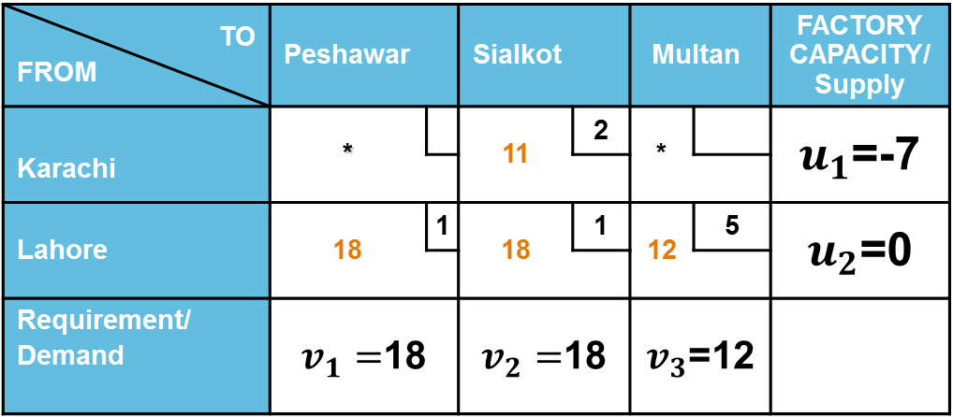

Modi method(u-v method)
For Allocated cell $c_{ij}=u_{i}+v_{j}$
Where you find the highest allocated row or column put that one equal to zero
TO FROM | Peshawar |  | Sialkot |  | Multan |  | FACTORY CAPACITY/Supply
Karachi | * |  | 11 | 2 | * |  | $u_{1}$=-7
Lahore | 18 | 1 | 18 | 1 | 12 | 5 | $u_{2}$=0
Requirement/ Demand | $v_{1}=$18 |  | $v_{2}=$18 |  | $v_{3}$=12

Slide 6
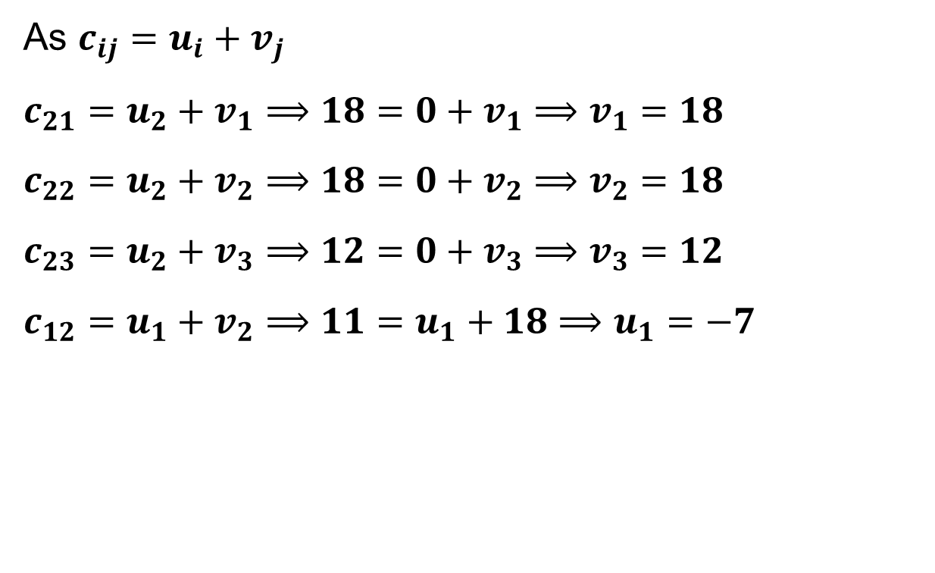
Modi method(u-v method)
As $c_{ij}=u_{i}+v_{j}$
$c_{21}=u_{2}+v_{1}⟹18=0+v_{1}$ $⟹v_{1}=18$
$c_{22}=u_{2}+v_{2}⟹18=0+v_{2}$ $⟹v_{2}=18$
$c_{23}=u_{2}+v_{3}⟹12=0+v_{3}$ $⟹v_{3}=12$
$c_{12}=u_{1}+v_{2}⟹11=u_{1}+18$ $⟹u_{1}=−7$

Slide 7
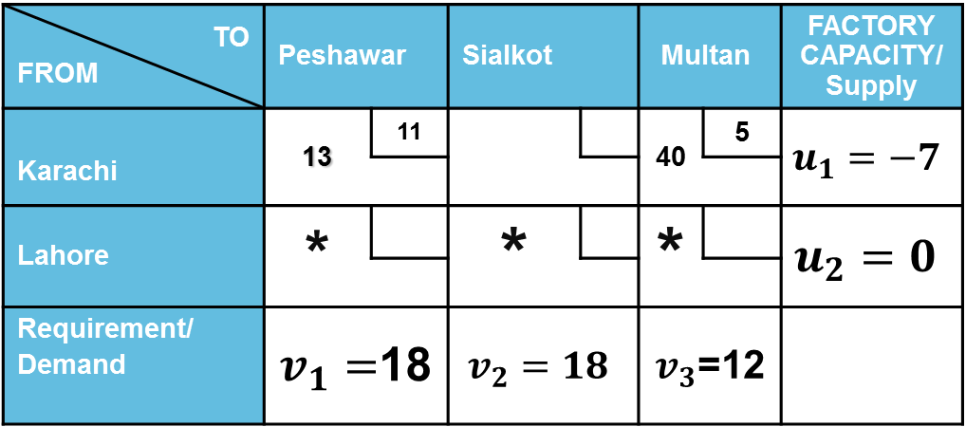

Modi method(u-v method)
For Non-allocated cell $c_{ij}−(u_{i}+v_{j})≥0$
TO FROM | Peshawar |  | Sialkot |  | Multan |  | FACTORY CAPACITY/Supply
Karachi | 13 | 11 |  |  | 40 | 5 | $$u_{1}=−7$$
Lahore | * |  | * |  | * |  | $$u_{2}=0$$
Requirement/ Demand | $v_{1}=$18 |  | $$v_{2}=18$$ |  | $v_{3}$=12

Slide 8
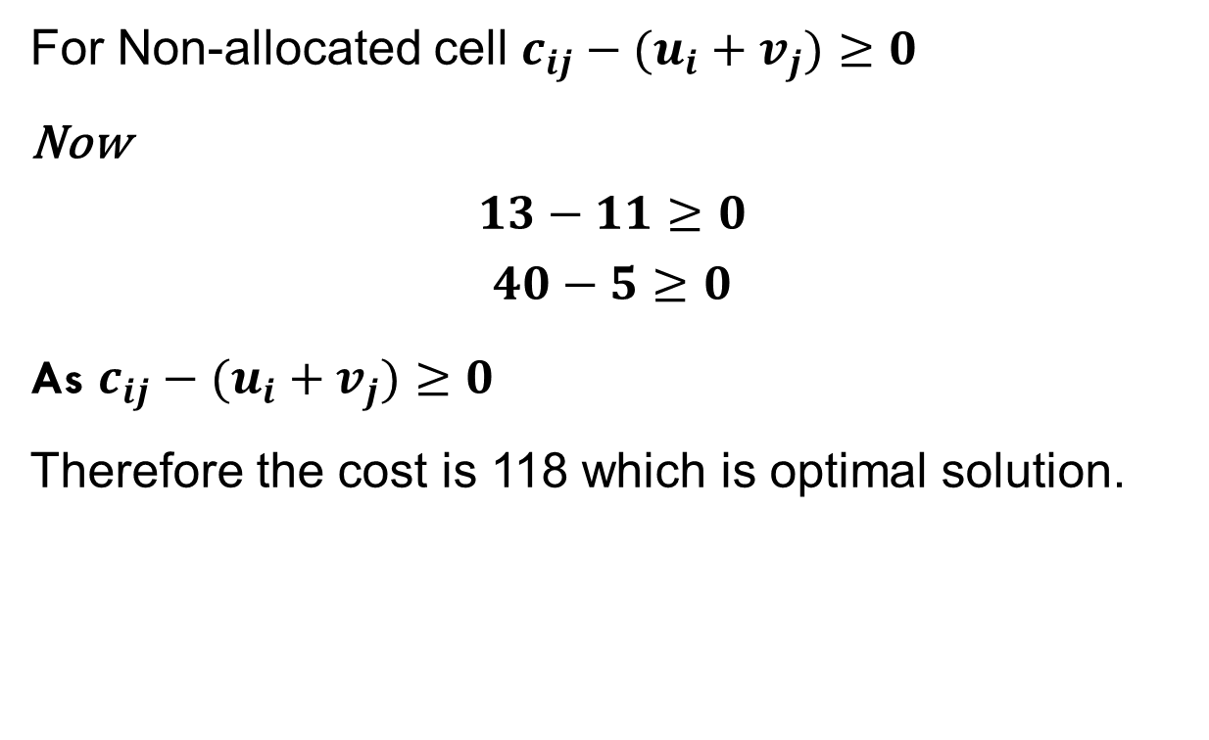
Modi method(u-v method)
For Non-allocated cell $c_{ij}−(u_{i}+v_{j})≥0$
Now
$$13−11≥0$$
$$40−5≥0$$
As $c_{ij}−(u_{i}+v_{j})≥0$
Therefore the cost is 118 which is optimal solution.

Slide 9
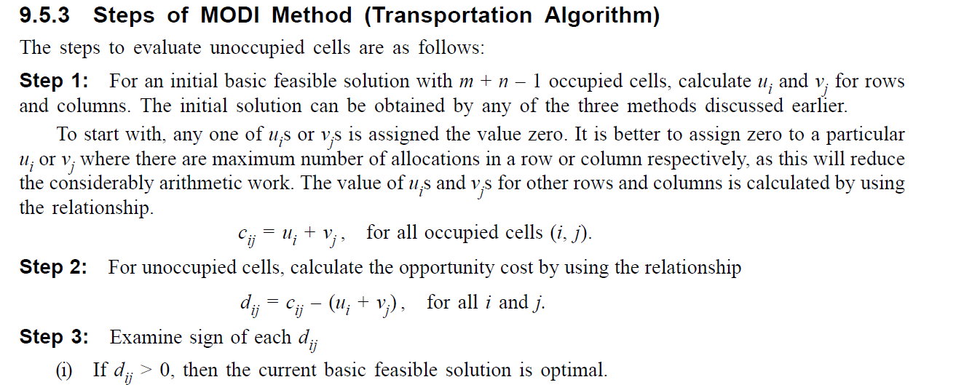

Slide 10
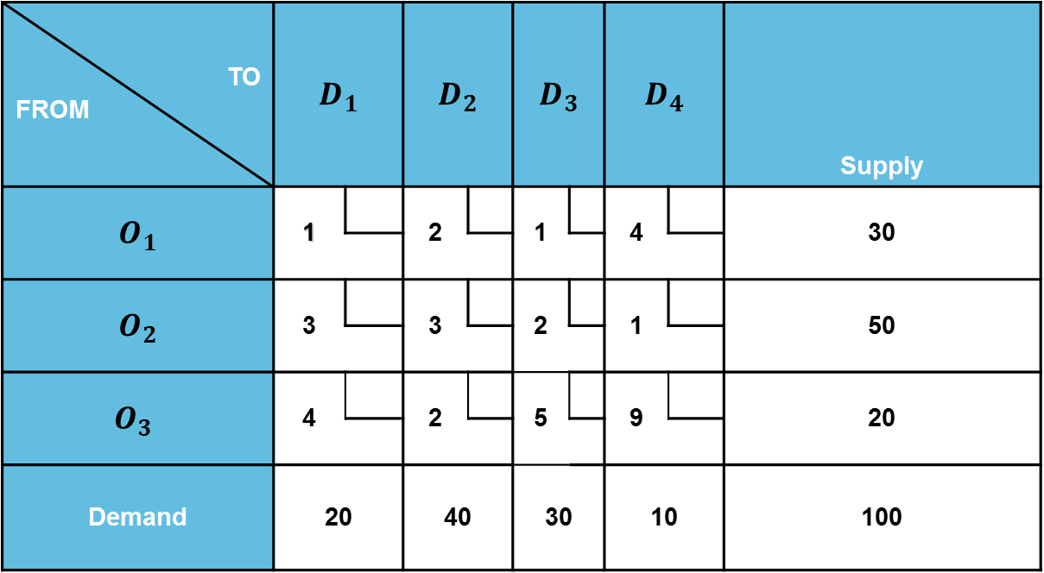
Modi method (u-v method)
TO FROM | $$D_{1}$$ |  | $$D_{2}$$ |  | $$D_{3}$$ |  | $$D_{4}$$ |  | Supply
$$O_{1}$$ | 1 |  | 2 |  | 1 |  | 4 |  | 30
$$O_{2}$$ | 3 |  | 3 |  | 2 |  | 1 |  | 50
$$O_{3}$$ | 4 |  | 2 |  | 5 |  | 9 |  | 20
Demand | 20 |  | 40 |  | 30 |  | 10 |  | 100

Slide 11
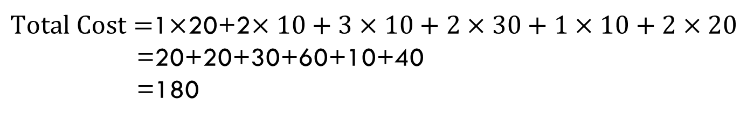
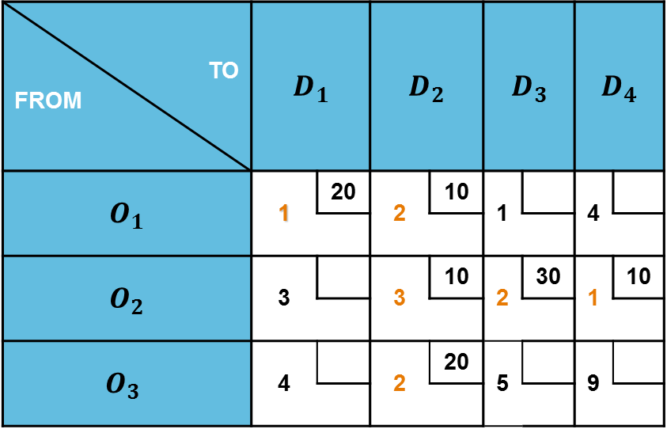
Modi method (u-v method)
TO FROM | $$D_{1}$$ |  | $$D_{2}$$ |  | $$D_{3}$$ |  | $$D_{4}$$
$$O_{1}$$ | 1 | 20 | 2 | 10 | 1 |  | 4
$$O_{2}$$ | 3 |  | 3 | 10 | 2 | 30 | 1 | 10
$$O_{3}$$ | 4 |  | 2 | 20 | 5 |  | 9
$Total Cost=$1$×$20+2$×10+3×10+2×30+1×10+2×20$
=20+20+30+60+10+40
=180

Slide 12
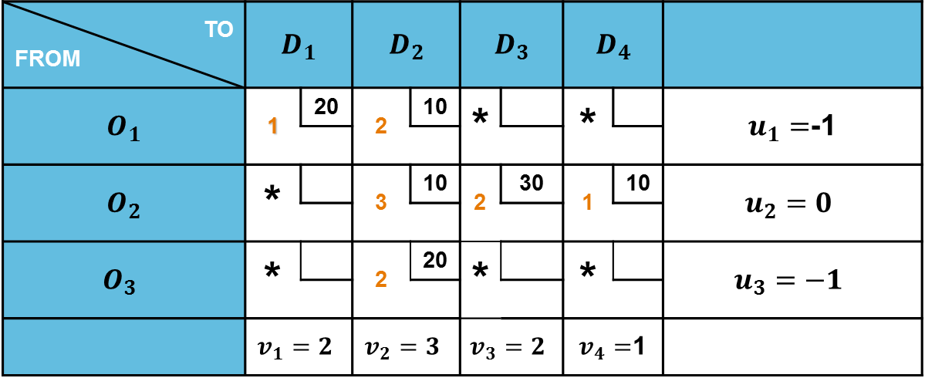
Modi method(u-v method)
For Allocated cell $c_{ij}=u_{i}+v_{j}$
Where you find the highest allocated row or column put that one equal to zero
TO FROM | $$D_{1}$$ |  | $$D_{2}$$ |  | $$D_{3}$$ |  | $$D_{4}$$
$$O_{1}$$ | 1 | 20 | 2 | 10 | * |  | * |  | $u_{1}=$-1
$$O_{2}$$ | * |  | 3 | 10 | 2 | 30 | 1 | 10 | $$u_{2}=0$$
$$O_{3}$$ | * |  | 2 | 20 | * |  | * |  | $$u_{3}=−1$$
 | $$v_{1}=2$$ |  | $$v_{2}=3$$ |  | $$v_{3}=2$$ |  | $v_{4}=$1

Slide 13
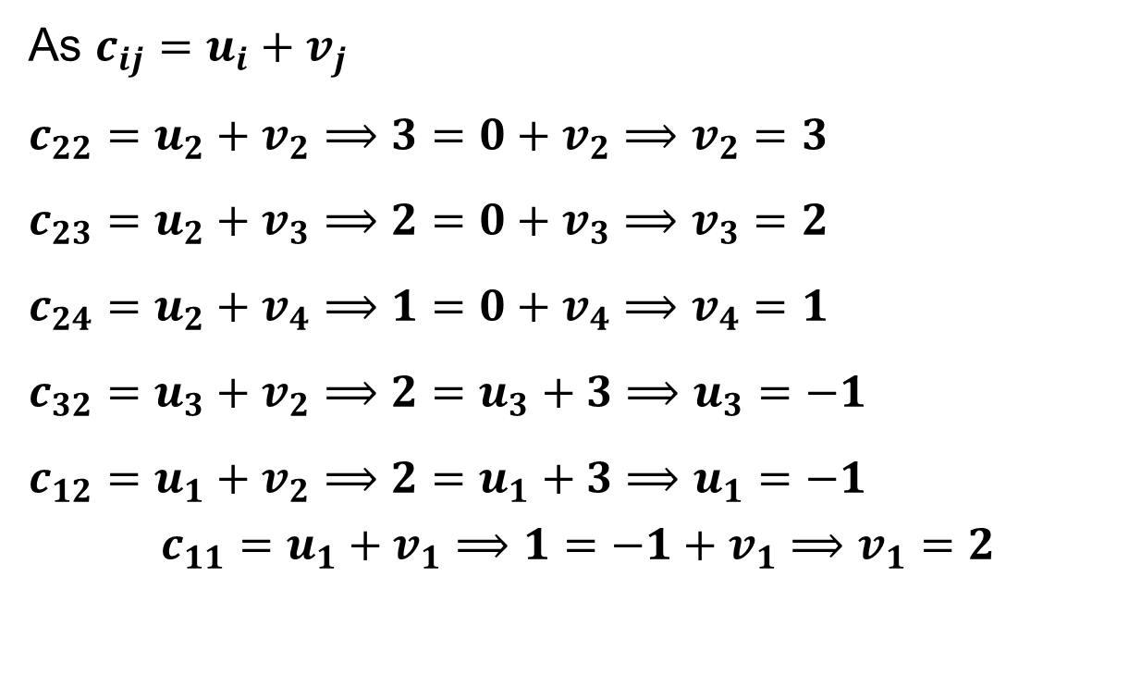
Modi method(u-v method)
As $c_{ij}=u_{i}+v_{j}$
$c_{22}=u_{2}+v_{2}⟹3=0+v_{2}$ $⟹v_{2}=3$
$c_{23}=u_{2}+v_{3}⟹2=0+v_{3}$ $⟹v_{3}=2$
$c_{24}=u_{2}+v_{4}⟹1=0+v_{4}$ $⟹v_{4}=1$
$c_{32}=u_{3}+v_{2}⟹2=u_{3}+3$ $⟹u_{3}=−1$
$c_{12}=u_{1}+v_{2}⟹2=u_{1}+3$ $⟹u_{1}=−1$
$$c_{11}=u_{1}+v_{1}⟹1=−1+v_{1}⟹v_{1}=2$$

Slide 14

Modi method(u-v method)
For Non-allocated cell $c_{ij}−(u_{i}+v_{j})≥0$
TO FROM | $$D_{1}$$ |  | $$D_{2}$$ |  | $$D_{3}$$ |  | $$D_{4}$$
$$O_{1}$$ | * |  | * |  | 1 |  | 4 | 0 | $u_{1}=$-1
$$O_{2}$$ | 3 | 2 | * |  | * |  | * |  | $$u_{2}=0$$
$$O_{3}$$ | 4 | 1 | * |  | 5 | 1 | 9 | 0 | $$u_{3}=−1$$
 | $$v_{1}=2$$ |  | $$v_{2}=3$$ |  | $$v_{3}=2$$ |  | $v_{4}=$1

Slide 15
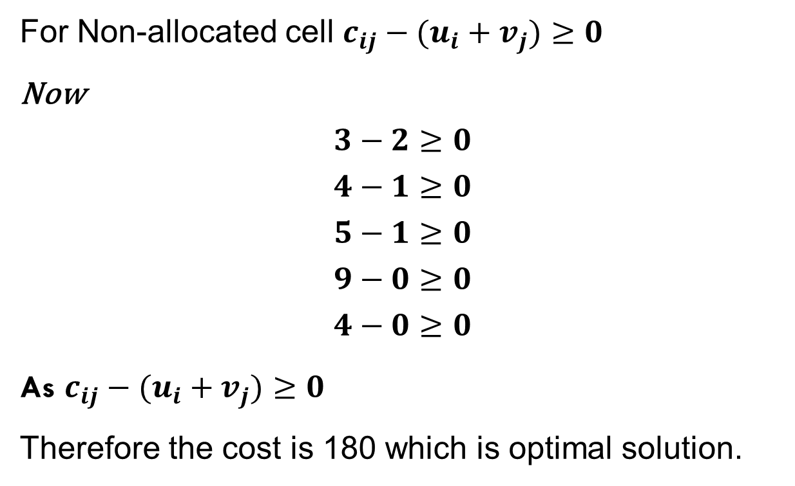
Modi method(u-v method)
For Non-allocated cell $c_{ij}−(u_{i}+v_{j})≥0$
Now
$$3−2≥0$$
$$4−1≥0$$
$$5−1≥0$$
$$9−0≥0$$
$$4−0≥0$$
As $c_{ij}−(u_{i}+v_{j})≥0$
Therefore the cost is 180 which is optimal solution.

Slide 16
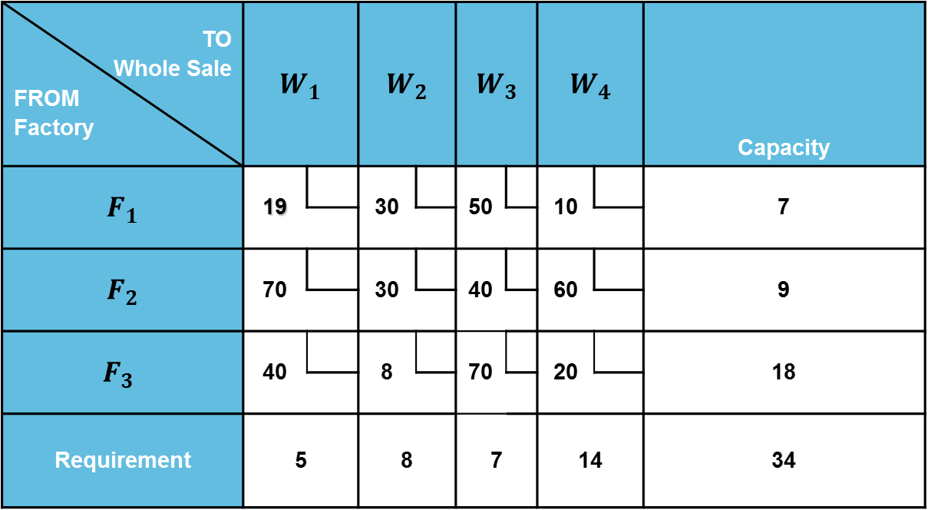
Modi method(u-v method)
TO Whole Sale FROM Factory | $$W_{1}$$ |  | $$W_{2}$$ |  | $$W_{3}$$ |  | $$W_{4}$$ |  | Capacity
$$F_{1}$$ | 19 |  | 30 |  | 50 |  | 10 |  | 7
$$F_{2}$$ | 70 |  | 30 |  | 40 |  | 60 |  | 9
$$F_{3}$$ | 40 |  | 8 |  | 70 |  | 20 |  | 18
Requirement | 5 |  | 8 |  | 7 |  | 14 |  | 34

Slide 17
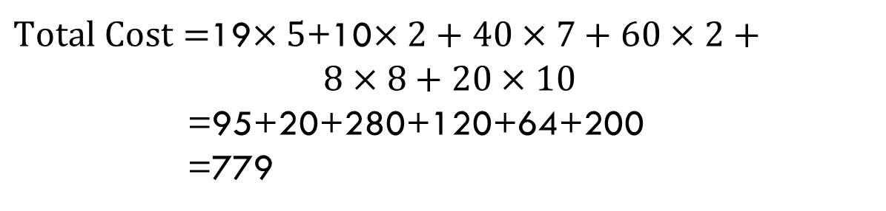
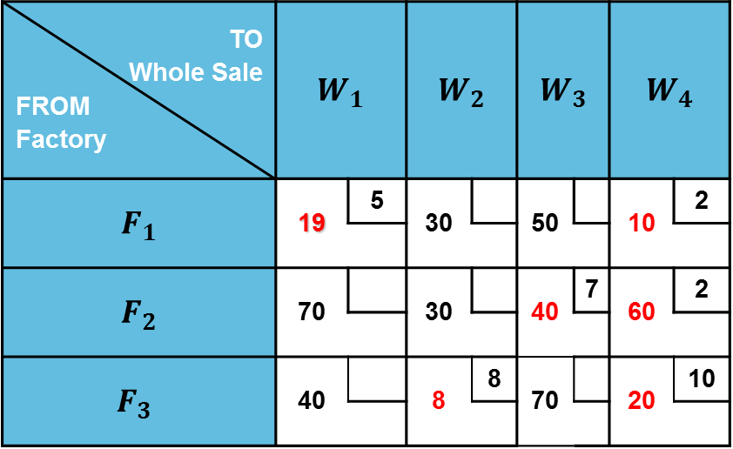
Modi method(u-v method)
TO Whole Sale FROM Factory | $$W_{1}$$ |  | $$W_{2}$$ |  | $$W_{3}$$ |  | $$W_{4}$$
$$F_{1}$$ | 19 | 5 | 30 |  | 50 |  | 10 | 2
$$F_{2}$$ | 70 |  | 30 |  | 40 | 7 | 60 | 2
$$F_{3}$$ | 40 |  | 8 | 8 | 70 |  | 20 | 10
$Total Cost=$19$×5$+10$×2+40×7+60×2+$
$$8×8+20×10$$
=95+20+280+120+64+200
=779

Slide 18
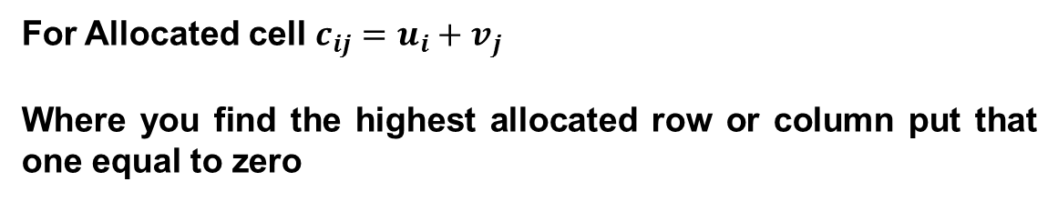
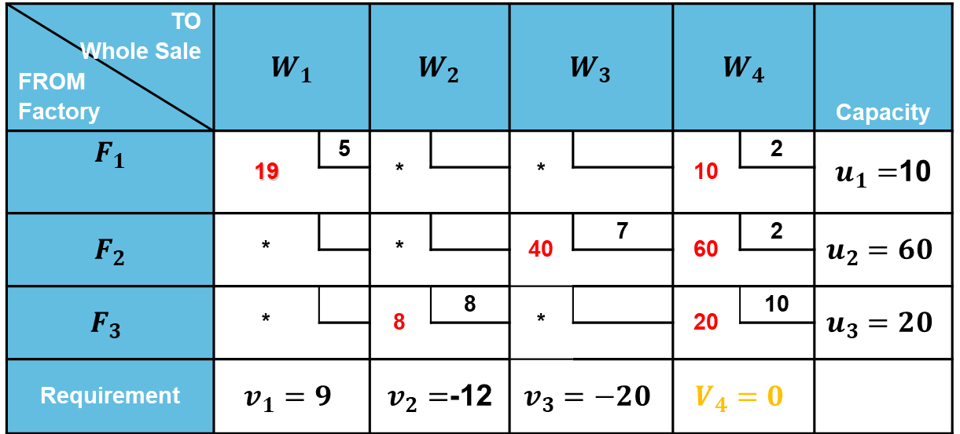
Modi method(u-v method)
For Allocated cell $c_{ij}=u_{i}+v_{j}$
Where you find the highest allocated row or column put that one equal to zero
TO Whole Sale FROM Factory | $$W_{1}$$ |  | $$W_{2}$$ |  | $$W_{3}$$ |  | $$W_{4}$$ |  | Capacity
$$F_{1}$$ | 19 | 5 | * |  | * |  | 10 | 2 | $u_{1}=$10
$$F_{2}$$ | * |  | * |  | 40 | 7 | 60 | 2 | $$u_{2}=60$$
$$F_{3}$$ | * |  | 8 | 8 | * |  | 20 | 10 | $$u_{3}=20$$
Requirement | $$v_{1}=9$$ |  | $v_{2}=$-12 |  | $$v_{3}=−20$$ |  | $$V_{4}=0$$

Slide 19
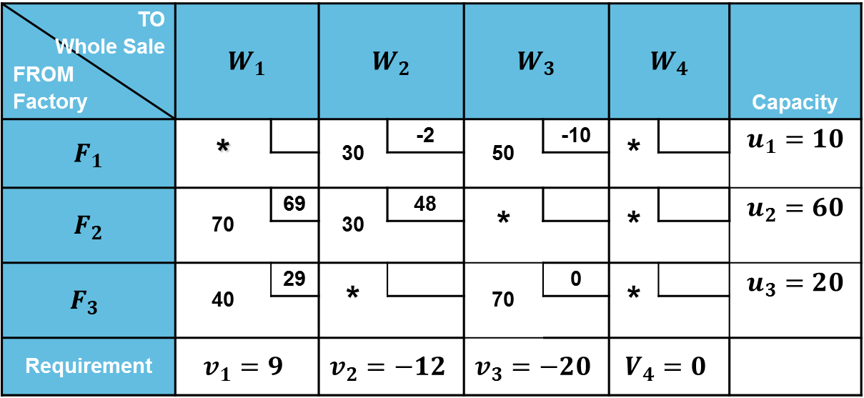
Modi method(u-v method)
For Non-allocated cell $c_{ij}−(u_{i}+v_{j})≥0$
TO Whole Sale FROM Factory | $$W_{1}$$ |  | $$W_{2}$$ |  | $$W_{3}$$ |  | $$W_{4}$$ |  | Capacity
$$F_{1}$$ | * |  | 30 | -2 | 50 | -10 | * |  | $$u_{1}=10$$
$$F_{2}$$ | 70 | 69 | 30 | 48 | * |  | * |  | $$u_{2}=60$$
$$F_{3}$$ | 40 | 29 | * |  | 70 | 0 | * |  | $$u_{3}=20$$
Requirement | $$v_{1}=9$$ |  | $$v_{2}=−12$$ |  | $$v_{3}=−20$$ |  | $$V_{4}=0$$

Slide 20

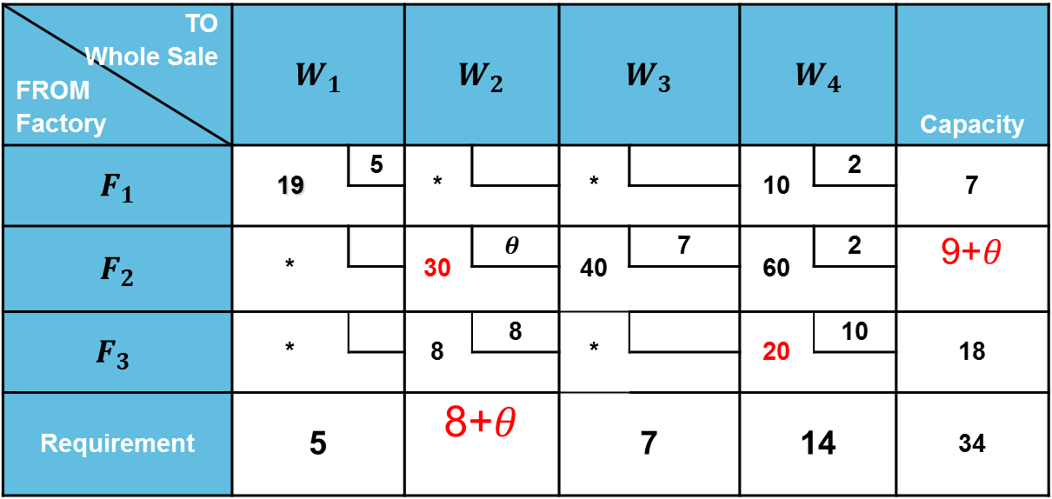
Modi method(u-v method)
$$c_{ij}−\left(u_{i}+v_{j}\right)<0,$$
Which is wrong therefore putting the value of $c_{22}$ at allocated cell table
At $c_{22}$
TO Whole Sale FROM Factory | $$W_{1}$$ |  | $$W_{2}$$ |  | $$W_{3}$$ |  | $$W_{4}$$ |  | Capacity
$$F_{1}$$ | 19 | 5 | * |  | * |  | 10 | 2 | 7
$$F_{2}$$ | * |  | 30 | $$θ$$ | 40 | 7 | 60 | 2 | 9+$θ$
$$F_{3}$$ | * |  | 8 | 8 | * |  | 20 | 10 | 18
Requirement | 5 |  | 8+$θ$ |  | 7 |  | 14 |  | 34

Slide 21
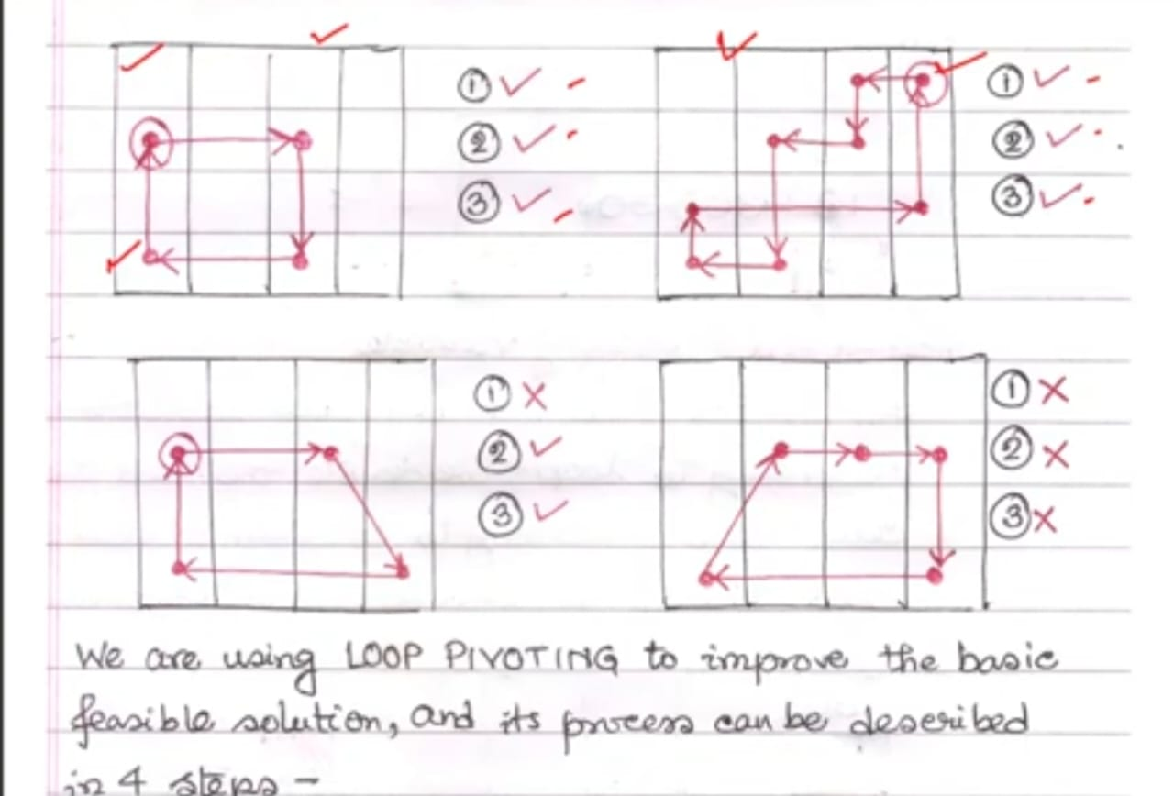
Loop
Loop is an ordered sequence of at least 4 different cells that satisfy three conditions:
Any two consecutive cells lie in either the same row or same column.
No three or more consecutive cells lie in the same row or same column.
The last cell is in the same row or same column as the first cell.

Slide 22
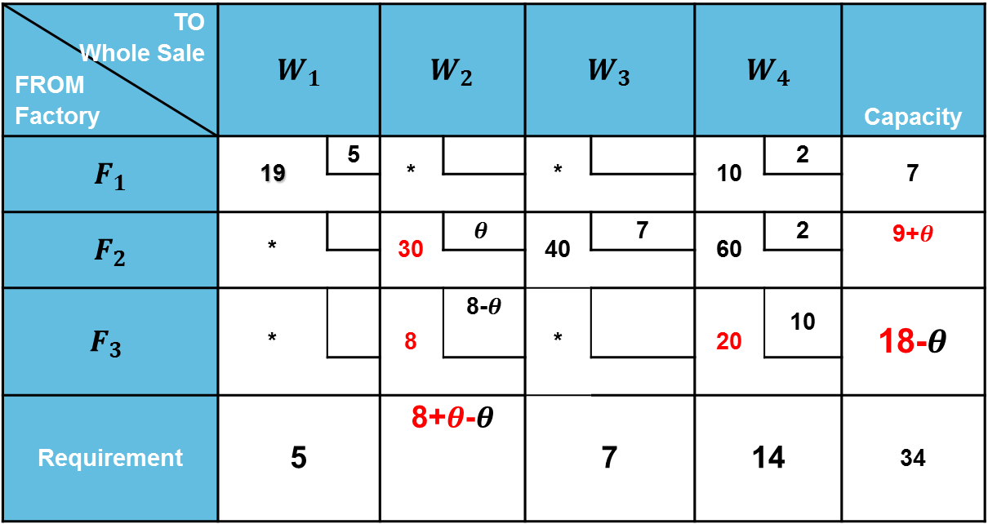
Modi method(u-v method)
TO Whole Sale FROM Factory | $$W_{1}$$ |  | $$W_{2}$$ |  | $$W_{3}$$ |  | $$W_{4}$$ |  | Capacity
$$F_{1}$$ | 19 | 5 | * |  | * |  | 10 | 2 | 7
$$F_{2}$$ | * |  | 30 | $$θ$$ | 40 | 7 | 60 | 2 | 9+$θ$
$$F_{3}$$ | * |  | 8 | 8-$θ$ | * |  | 20 | 10 | 18-$θ$
Requirement | 5 |  | 8+$θ$-$θ$ |  | 7 |  | 14 |  | 34

Slide 23
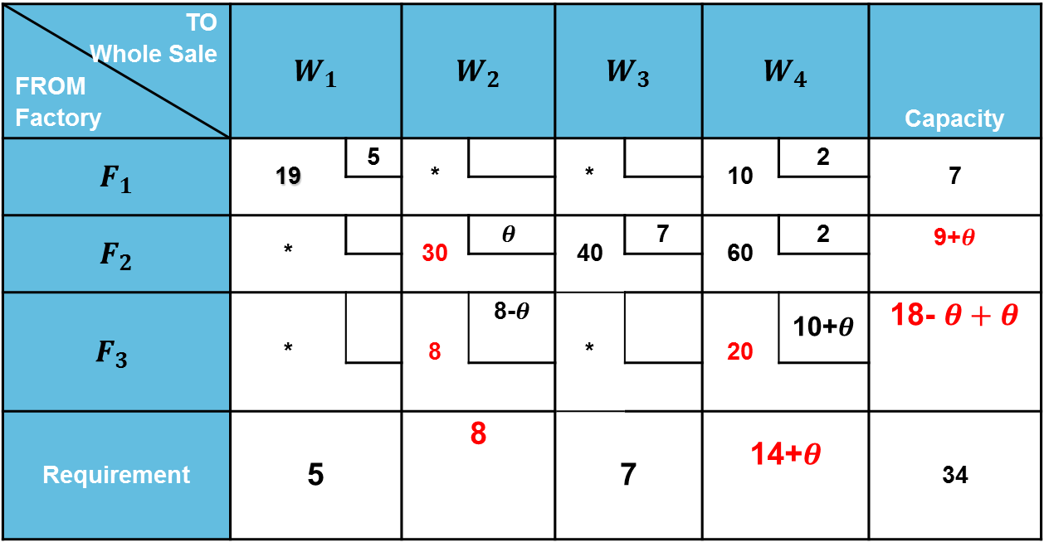
Modi method(u-v method)
TO Whole Sale FROM Factory | $$W_{1}$$ |  | $$W_{2}$$ |  | $$W_{3}$$ |  | $$W_{4}$$ |  | Capacity
$$F_{1}$$ | 19 | 5 | * |  | * |  | 10 | 2 | 7
$$F_{2}$$ | * |  | 30 | $$θ$$ | 40 | 7 | 60 | 2 | 9+$θ$
$$F_{3}$$ | * |  | 8 | 8-$θ$ | * |  | 20 | 10+$θ$ | 18- $θ+θ$
Requirement | 5 |  | 8 |  | 7 |  | 14+$θ$ |  | 34

Slide 24
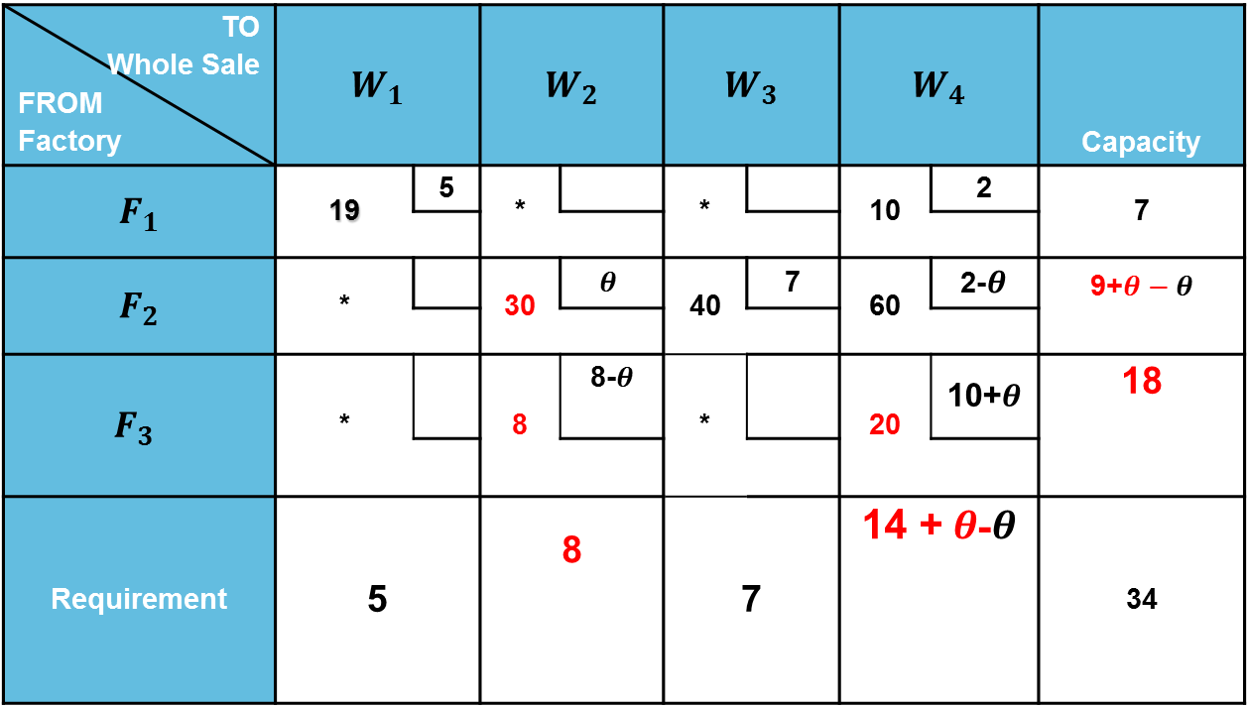
Modi method(u-v method)
TO Whole Sale FROM Factory | $$W_{1}$$ |  | $$W_{2}$$ |  | $$W_{3}$$ |  | $$W_{4}$$ |  | Capacity
$$F_{1}$$ | 19 | 5 | * |  | * |  | 10 | 2 | 7
$$F_{2}$$ | * |  | 30 | $$θ$$ | 40 | 7 | 60 | 2-$θ$ | 9+$θ−θ$
$$F_{3}$$ | * |  | 8 | 8-$θ$ | * |  | 20 | 10+$θ$ | 18
Requirement | 5 |  | 8 |  | 7 |  | 14 +$θ$-$θ$ |  | 34

Slide 25


Modi method(u-v method)
$$2−θ=0$$
$$θ=2$$
$Total Cost=$19$×5$ + 30$×2+40×7+10×2+$
$$8×6+20×12$$
=95+60+280+20+48+240
=743
$$Min (8−θ, 2−θ)$$

Slide 26
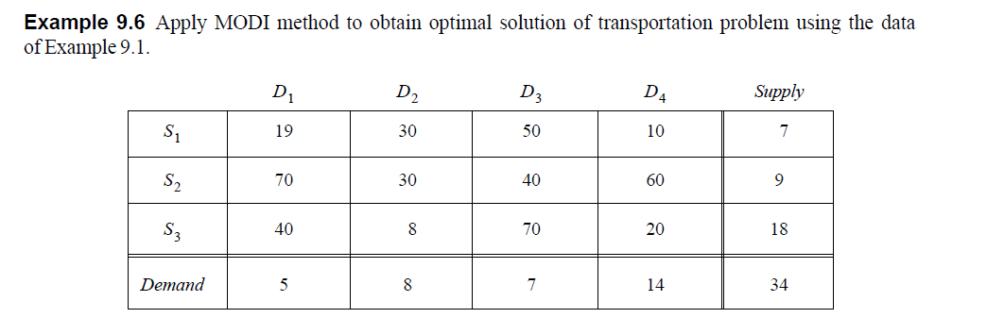
TASK practice Chap 9 examples
Book: Operations-research-theory-and-applications-by-j.-k.-sharma

Slide 27
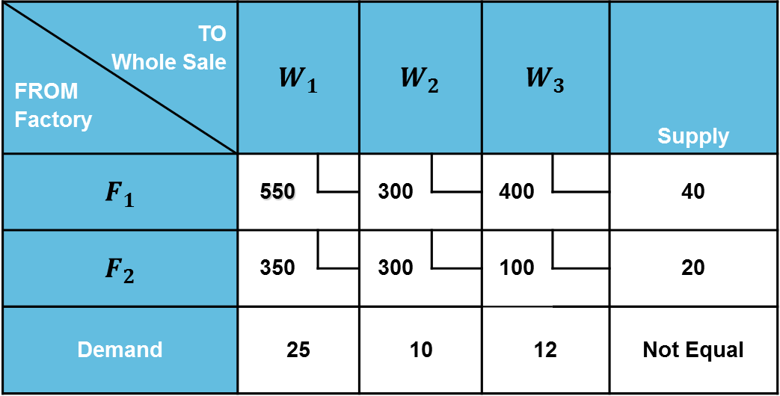
NWCM (Unbalanced)
TO Whole Sale FROM Factory | $$W_{1}$$ |  | $$W_{2}$$ |  | $$W_{3}$$ |  | Supply
$$F_{1}$$ | 550 |  | 300 |  | 400 |  | 40
$$F_{2}$$ | 350 |  | 300 |  | 100 |  | 20
Demand | 25 |  | 10 |  | 12 |  | Not Equal

Slide 28
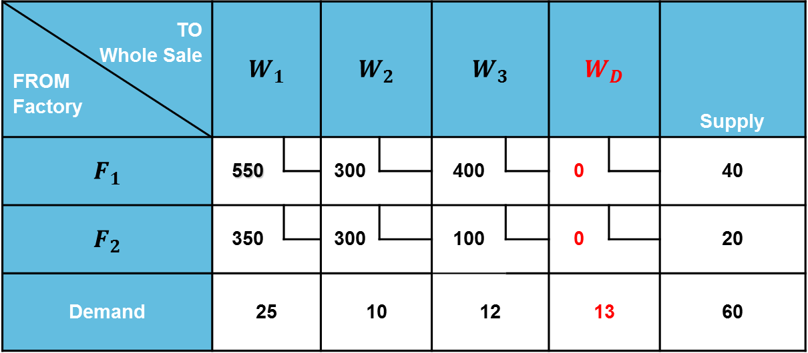
NWCM (Unbalanced)
TO Whole Sale FROM Factory | $$W_{1}$$ |  | $$W_{2}$$ |  | $$W_{3}$$ |  | $$W_{D}$$ |  | Supply
$$F_{1}$$ | 550 |  | 300 |  | 400 |  | 0 |  | 40
$$F_{2}$$ | 350 |  | 300 |  | 100 |  | 0 |  | 20
Demand | 25 |  | 10 |  | 12 |  | 13 |  | 60

Slide 29
Initial basic feasible solution
m+n-1,
Where m = no of rows,
n=no of columns,
m=2,
n=4,
m+n-1=2+4-1=5

Slide 30
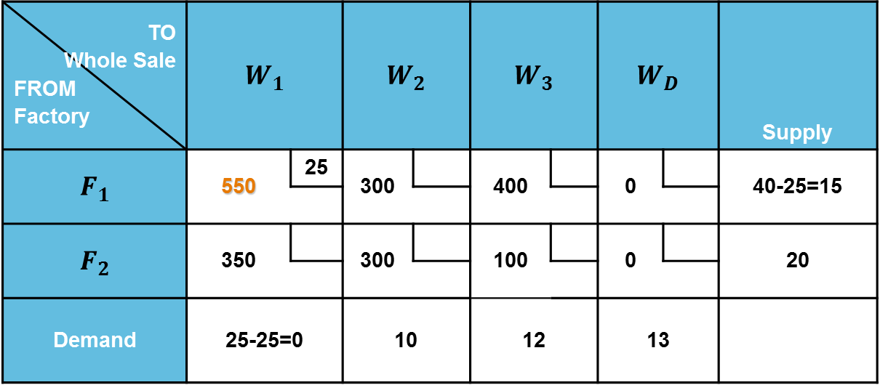
NWCM (Unbalanced)
TO Whole Sale FROM Factory | $$W_{1}$$ |  | $$W_{2}$$ |  | $$W_{3}$$ |  | $$W_{D}$$ |  | Supply
$$F_{1}$$ | 550 | 25 | 300 |  | 400 |  | 0 |  | 40-25=15
$$F_{2}$$ | 350 |  | 300 |  | 100 |  | 0 |  | 20
Demand | 25-25=0 |  | 10 |  | 12 |  | 13

Slide 31
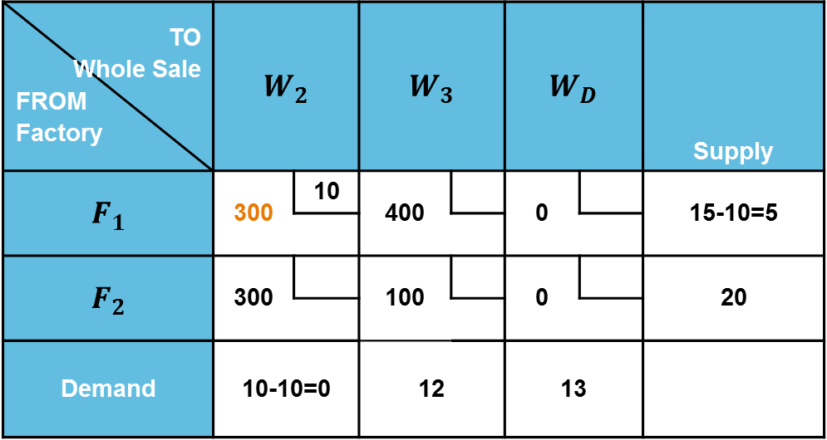
NWCM (Unbalanced)
TO Whole Sale FROM Factory | $$W_{2}$$ |  | $$W_{3}$$ |  | $$W_{D}$$ |  | Supply
$$F_{1}$$ | 300 | 10 | 400 |  | 0 |  | 15-10=5
$$F_{2}$$ | 300 |  | 100 |  | 0 |  | 20
Demand | 10-10=0 |  | 12 |  | 13

Slide 32
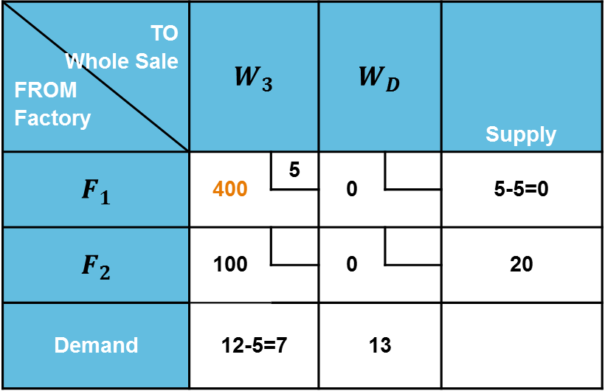
NWCM (Unbalanced)
TO Whole Sale FROM Factory | $$W_{3}$$ |  | $$W_{D}$$ |  | Supply
$$F_{1}$$ | 400 | 5 | 0 |  | 5-5=0
$$F_{2}$$ | 100 |  | 0 |  | 20
Demand | 12-5=7 |  | 13

Slide 33
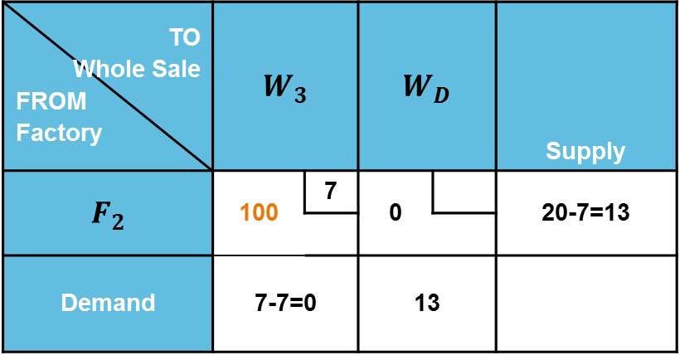
NWCM (Unbalanced)
TO Whole Sale FROM Factory | $$W_{3}$$ |  | $$W_{D}$$ |  | Supply
$$F_{2}$$ | 100 | 7 | 0 |  | 20-7=13
Demand | 7-7=0 |  | 13

Slide 34
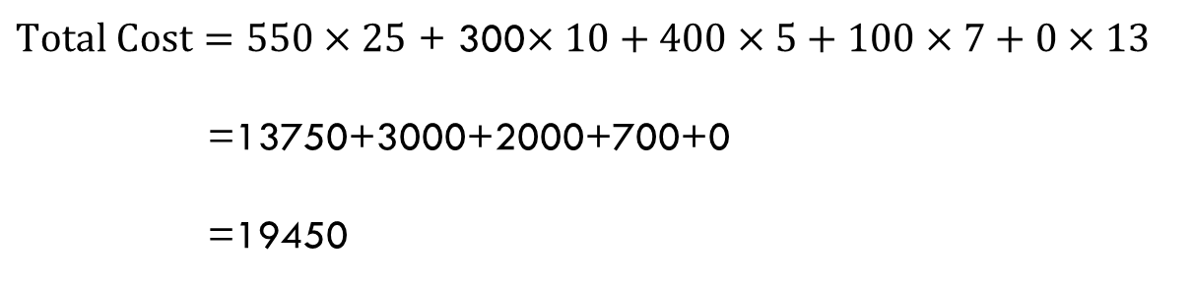
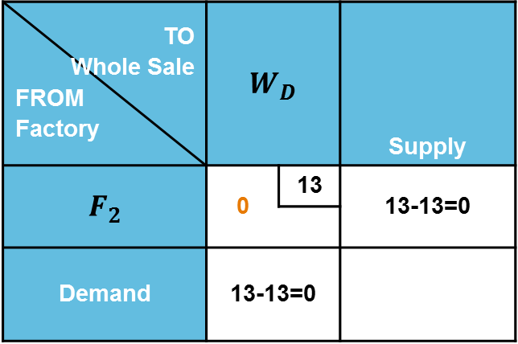
NWCM (Unbalanced)
TO Whole Sale FROM Factory | $$W_{D}$$ |  | Supply
$$F_{2}$$ | 0 | 13 | 13-13=0
Demand | 13-13=0
$Total Cost=550×25$ + 300$×10+400×5+100×7+0×13$
=13750+3000+2000+700+0
=19450

Slide 35
Least cost method (Unbalanced)
TO Whole Sale FROM Factory | $$W_{1}$$ |  | $$W_{2}$$ |  | $$W_{3}$$ |  | Supply
$$F_{1}$$ | 550 |  | 300 |  | 400 |  | 40
$$F_{2}$$ | 350 |  | 300 |  | 100 |  | 20
Demand | 25 |  | 10 |  | 12 |  | Not Equal

Slide 36
Least cost method (Unbalanced)
TO Whole Sale FROM Factory | $$W_{1}$$ |  | $$W_{2}$$ |  | $$W_{3}$$ |  | $$W_{D}$$ |  | Supply
$$F_{1}$$ | 550 |  | 300 |  | 400 |  | 0 |  | 40
$$F_{2}$$ | 350 |  | 300 |  | 100 |  | 0 |  | 20
Demand | 25 |  | 10 |  | 12 |  | 13 |  | 60

Slide 37
Initial basic feasible solution
m+n-1,
Where m = no of rows,
n=no of columns,
m=2,
n=4,
m+n-1=2+4-1=5

Slide 38
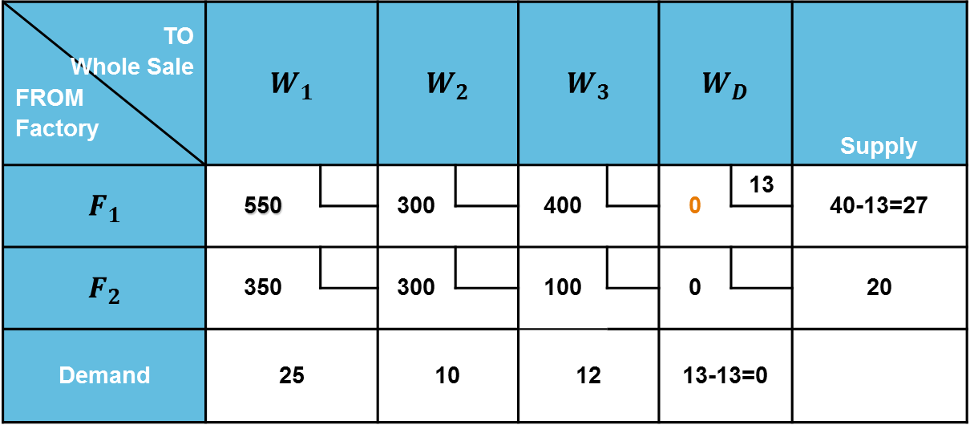
Least cost method (Unbalanced)
TO Whole Sale FROM Factory | $$W_{1}$$ |  | $$W_{2}$$ |  | $$W_{3}$$ |  | $$W_{D}$$ |  | Supply
$$F_{1}$$ | 550 |  | 300 |  | 400 |  | 0 | 13 | 40-13=27
$$F_{2}$$ | 350 |  | 300 |  | 100 |  | 0 |  | 20
Demand | 25 |  | 10 |  | 12 |  | 13-13=0

Slide 39
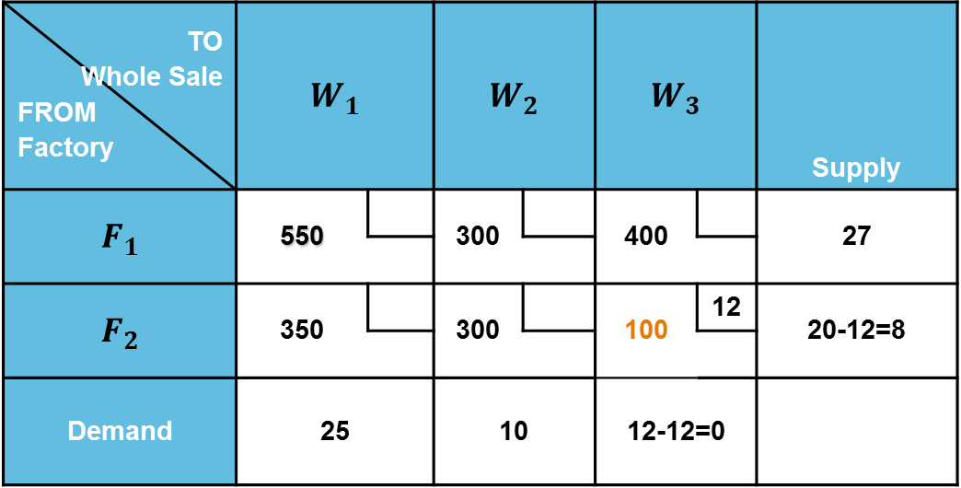
Least cost method (Unbalanced)
TO Whole Sale FROM Factory | $$W_{1}$$ |  | $$W_{2}$$ |  | $$W_{3}$$ |  | Supply
$$F_{1}$$ | 550 |  | 300 |  | 400 |  | 27
$$F_{2}$$ | 350 |  | 300 |  | 100 | 12 | 20-12=8
Demand | 25 |  | 10 |  | 12-12=0

Slide 40
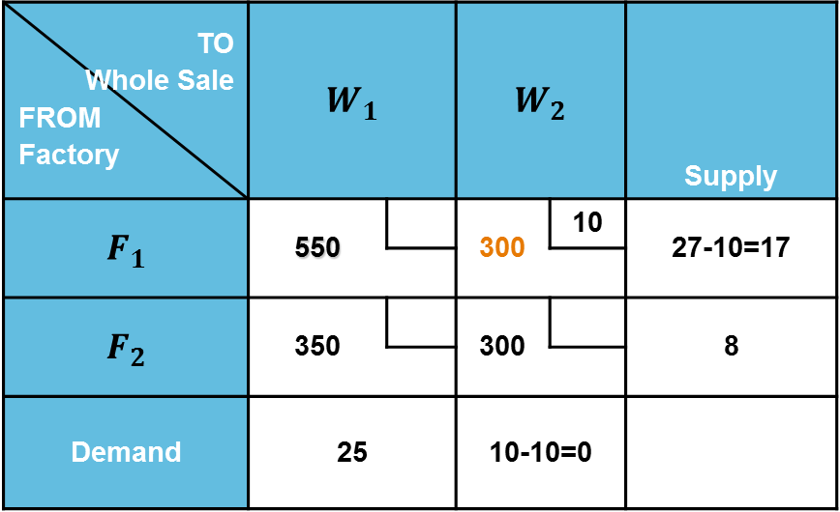
Least cost method (Unbalanced)
TO Whole Sale FROM Factory | $$W_{1}$$ |  | $$W_{2}$$ |  | Supply
$$F_{1}$$ | 550 |  | 300 | 10 | 27-10=17
$$F_{2}$$ | 350 |  | 300 |  | 8
Demand | 25 |  | 10-10=0

Slide 41
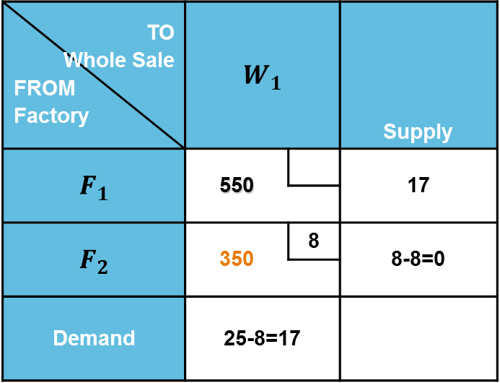
Least cost method (Unbalanced)
TO Whole Sale FROM Factory | $$W_{1}$$ |  | Supply
$$F_{1}$$ | 550 |  | 17
$$F_{2}$$ | 350 | 8 | 8-8=0
Demand | 25-8=17

Slide 42
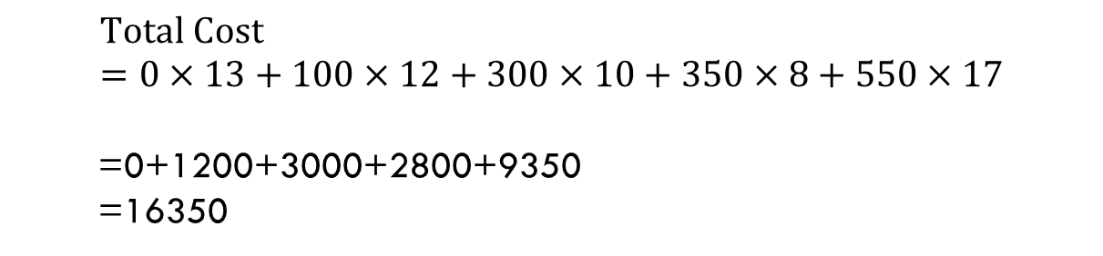
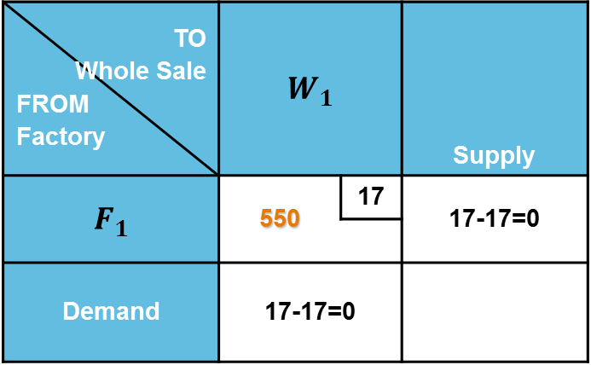
Least cost method (Unbalanced)
TO Whole Sale FROM Factory | $$W_{1}$$ |  | Supply
$$F_{1}$$ | 550 | 17 | 17-17=0
Demand | 17-17=0
$$Total Cost=0×13+100×12+300×10+350×8+550×17$$
=0+1200+3000+2800+9350
=16350

Slide 43
Vogel's approximation method (Unbalanced)
TO Whole Sale FROM Factory | $$W_{1}$$ |  | $$W_{2}$$ |  | $$W_{3}$$ |  | Supply
$$F_{1}$$ | 550 |  | 300 |  | 400 |  | 40
$$F_{2}$$ | 350 |  | 300 |  | 100 |  | 20
Demand | 25 |  | 10 |  | 12 |  | Not Equal

Slide 44
Vogel's approximation method (Unbalanced)
TO Whole Sale FROM Factory | $$W_{1}$$ |  | $$W_{2}$$ |  | $$W_{3}$$ |  | $$W_{D}$$ |  | Supply
$$F_{1}$$ | 550 |  | 300 |  | 400 |  | 0 |  | 40
$$F_{2}$$ | 350 |  | 300 |  | 100 |  | 0 |  | 20
Demand | 25 |  | 10 |  | 12 |  | 13 |  | 60

Slide 45
Vogel's approximation method (Unbalanced)
m+n-1,
Where m = no of rows,
n=no of columns,
m=2,
n=4,
m+n-1=2+4-1=5

Slide 46
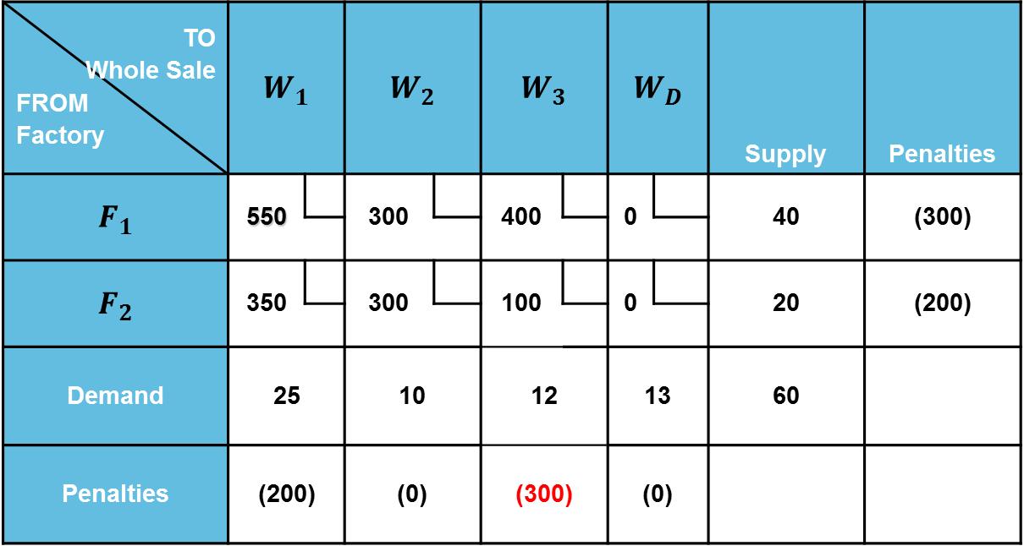
Vogel's approximation method (Unbalanced)
TO Whole Sale FROM Factory | $$W_{1}$$ |  | $$W_{2}$$ |  | $$W_{3}$$ |  | $$W_{D}$$ |  | Supply | Penalties
$$F_{1}$$ | 550 |  | 300 |  | 400 |  | 0 |  | 40 | (300)
$$F_{2}$$ | 350 |  | 300 |  | 100 |  | 0 |  | 20 | (200)
Demand | 25 |  | 10 |  | 12 |  | 13 |  | 60
Penalties | (200) |  | (0) |  | (300) |  | (0)

Slide 47
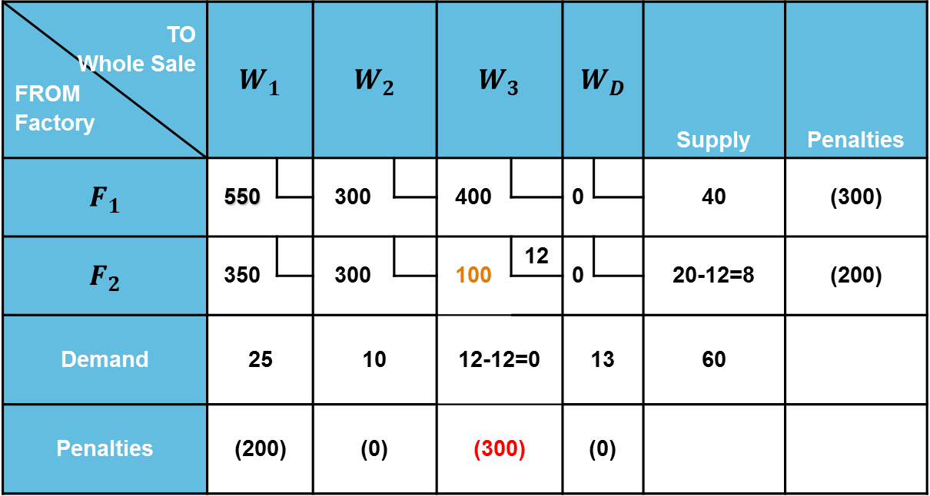
Vogel's approximation method (Unbalanced)
TO Whole Sale FROM Factory | $$W_{1}$$ |  | $$W_{2}$$ |  | $$W_{3}$$ |  | $$W_{D}$$ |  | Supply | Penalties
$$F_{1}$$ | 550 |  | 300 |  | 400 |  | 0 |  | 40 | (300)
$$F_{2}$$ | 350 |  | 300 |  | 100 | 12 | 0 |  | 20-12=8 | (200)
Demand | 25 |  | 10 |  | 12-12=0 |  | 13 |  | 60
Penalties | (200) |  | (0) |  | (300) |  | (0)

Slide 48
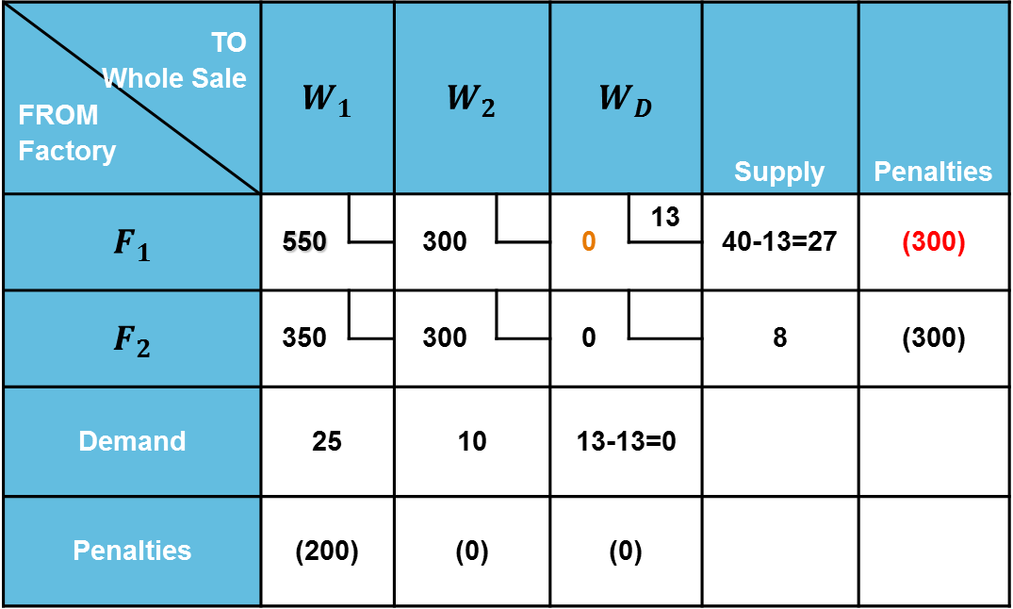
Vogel's approximation method (Unbalanced)
TO Whole Sale FROM Factory | $$W_{1}$$ |  | $$W_{2}$$ |  | $$W_{D}$$ |  | Supply | Penalties
$$F_{1}$$ | 550 |  | 300 |  | 0 | 13 | 40-13=27 | (300)
$$F_{2}$$ | 350 |  | 300 |  | 0 |  | 8 | (300)
Demand | 25 |  | 10 |  | 13-13=0
Penalties | (200) |  | (0) |  | (0)

Slide 49
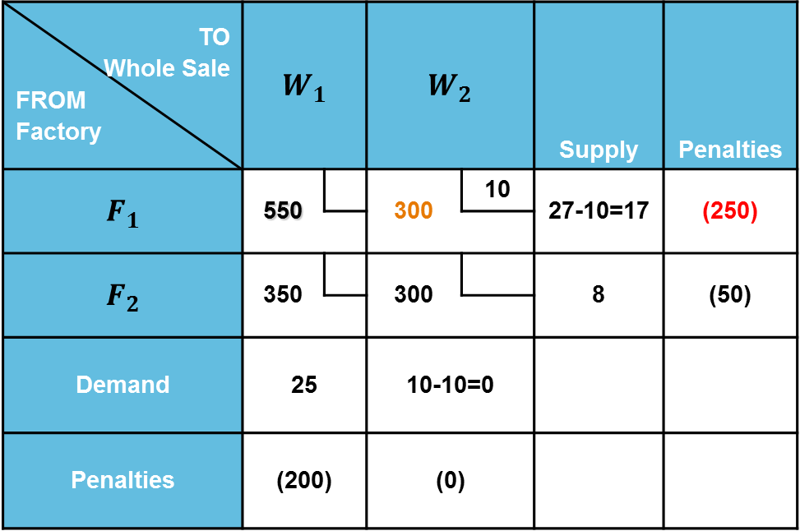
Vogel's approximation method (Unbalanced)
TO Whole Sale FROM Factory | $$W_{1}$$ |  | $$W_{2}$$ |  | Supply | Penalties
$$F_{1}$$ | 550 |  | 300 | 10 | 27-10=17 | (250)
$$F_{2}$$ | 350 |  | 300 |  | 8 | (50)
Demand | 25 |  | 10-10=0
Penalties | (200) |  | (0)

Slide 50
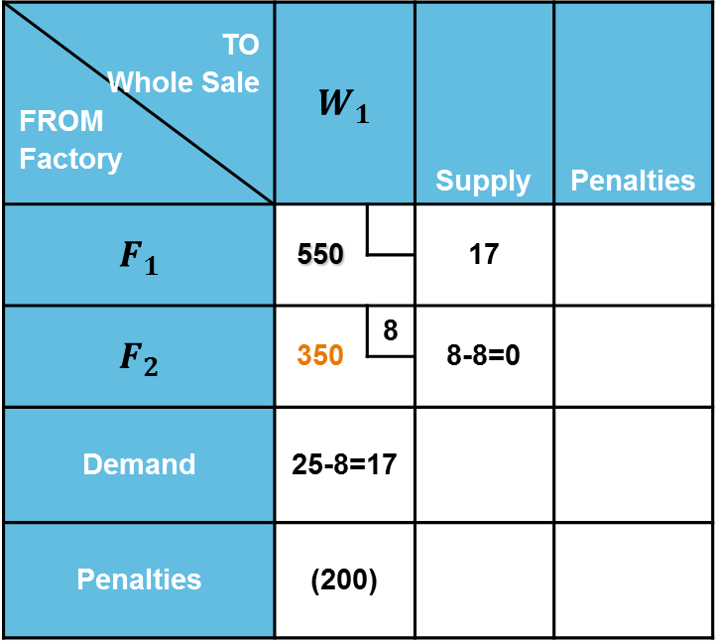
Vogel's approximation method (Unbalanced)
TO Whole Sale FROM Factory | $$W_{1}$$ |  | Supply | Penalties
$$F_{1}$$ | 550 |  | 17
$$F_{2}$$ | 350 | 8 | 8-8=0
Demand | 25-8=17
Penalties | (200)

Slide 51
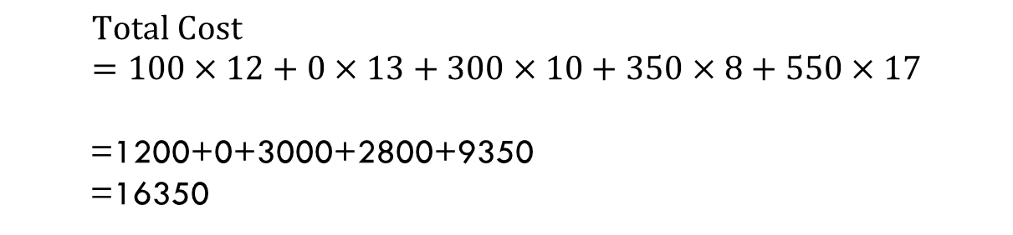
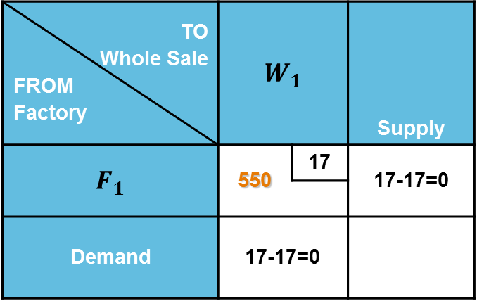
Vogel's approximation method (Unbalanced)
TO Whole Sale FROM Factory | $$W_{1}$$ |  | Supply
$$F_{1}$$ | 550 | 17 | 17-17=0
Demand | 17-17=0
$$Total Cost=100×12+0×13+300×10+350×8+550×17$$
=1200+0+3000+2800+9350
=16350

Slide 52
Thank you!

